Slide 1
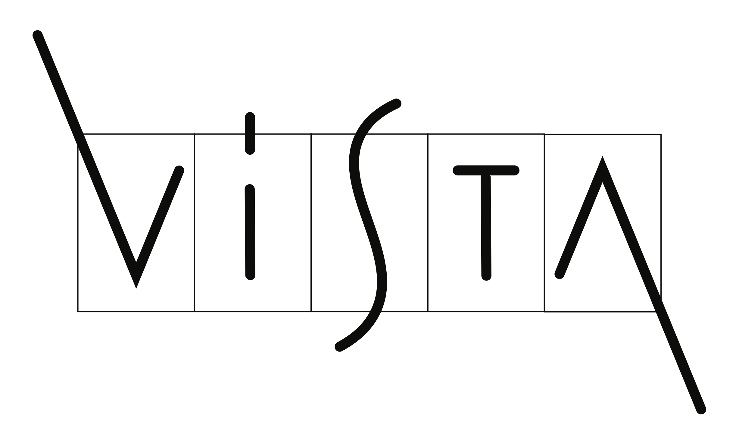

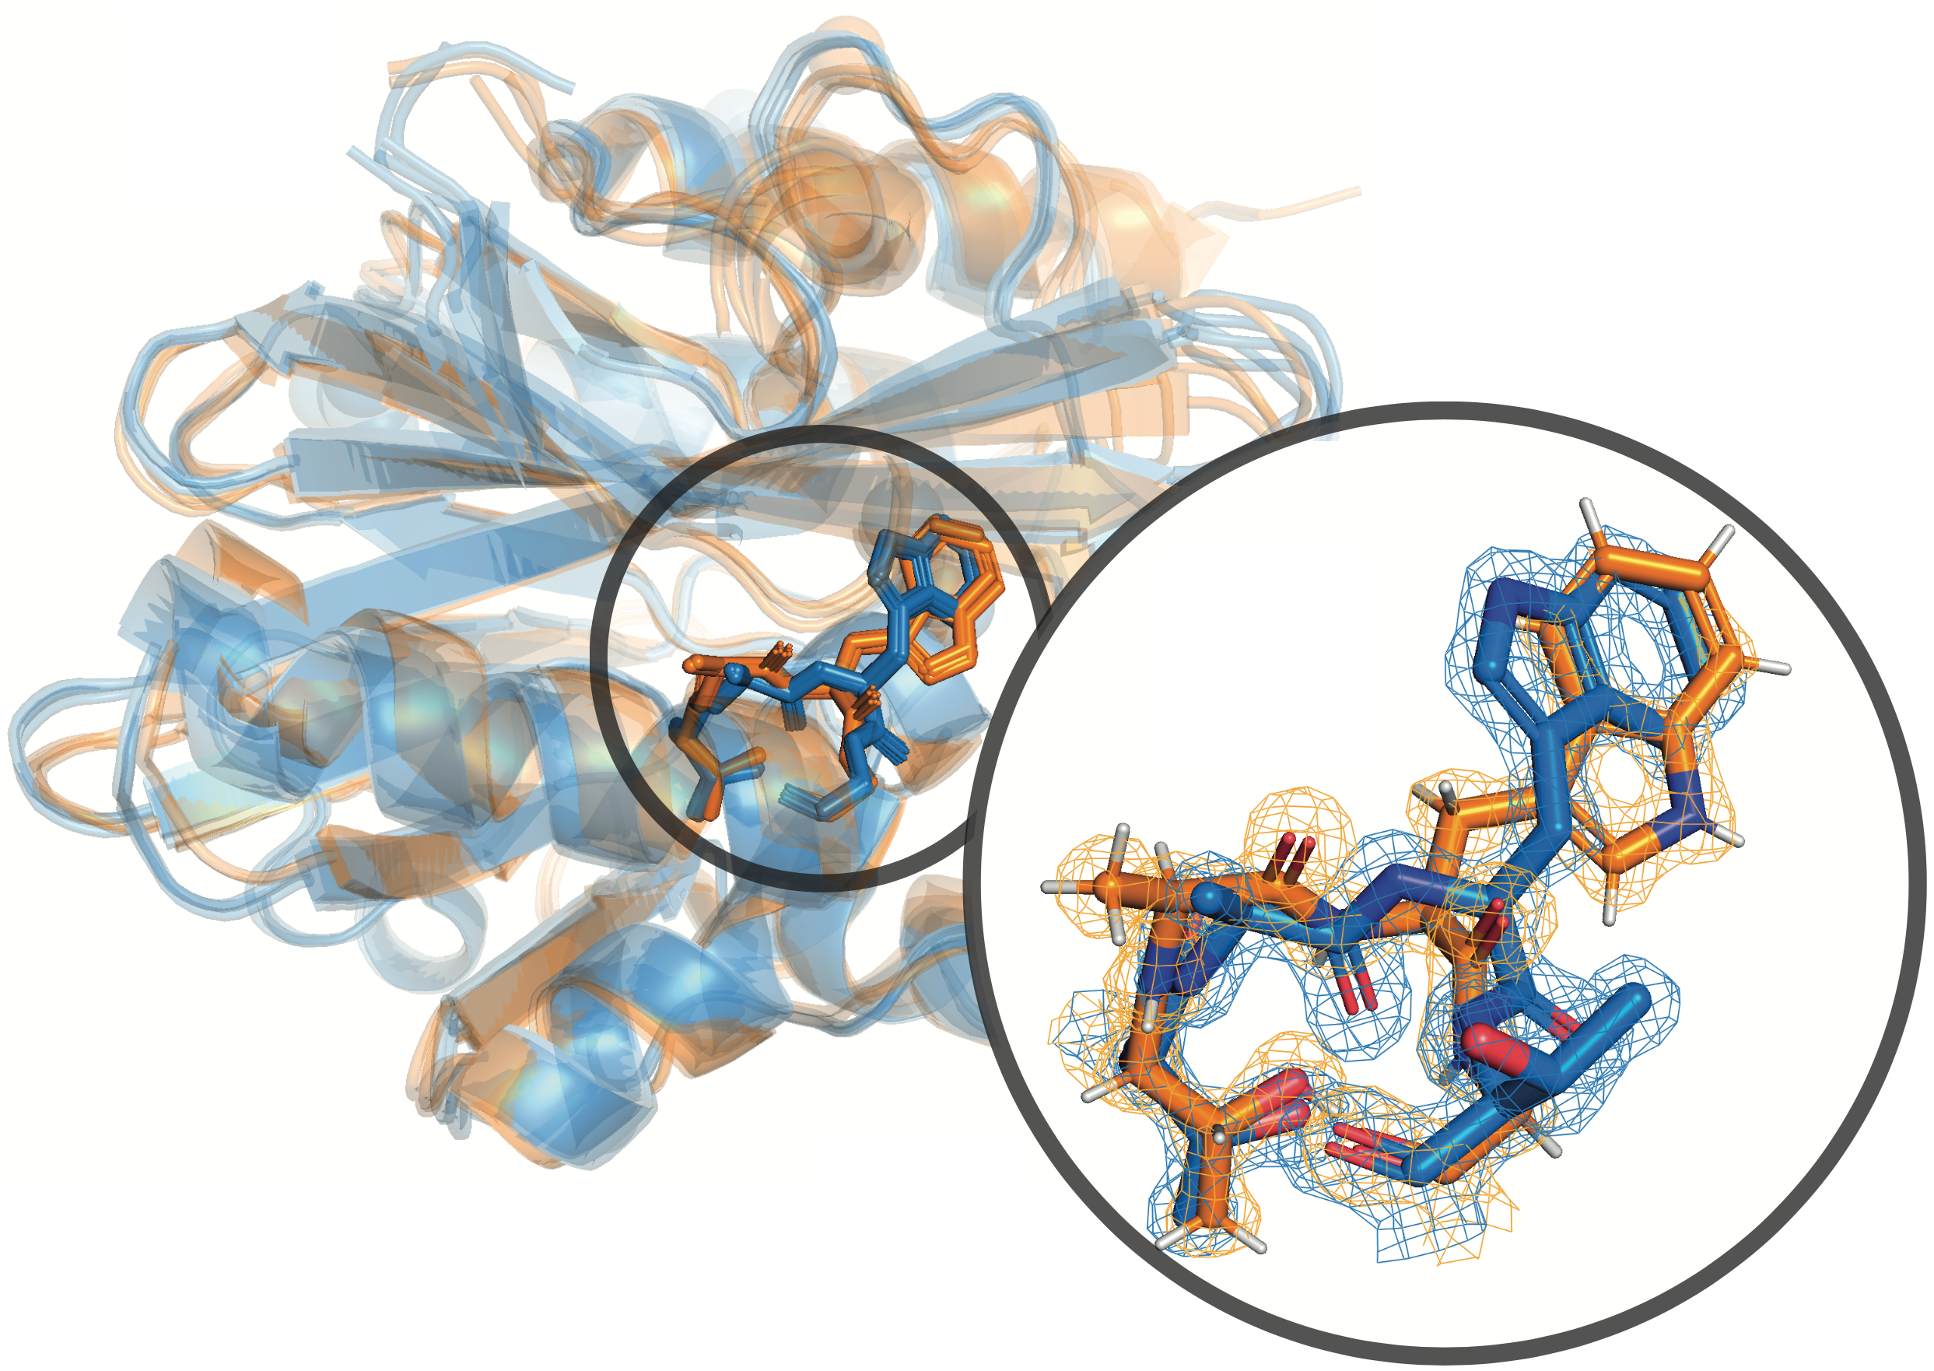
A Twist in the Protein Folding Dogma
Do proteins remember their genetic coding?
Alex Bronstein @ CS, Technion
Joint work with Aviv A. Rosenberg & Ailie Marx
May 2023

Slide 2
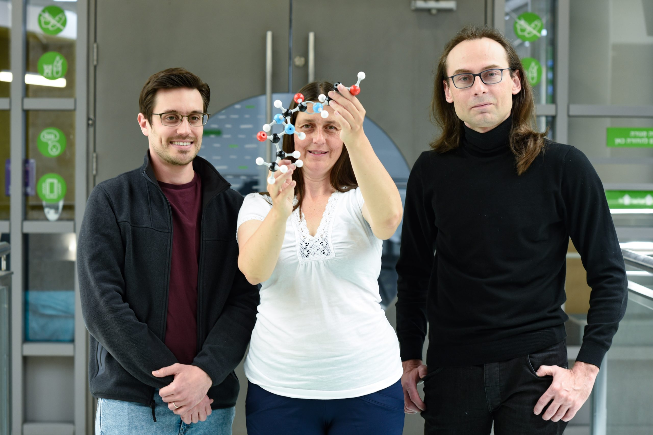
The AAA team
Aviv Rosenberg
Ailie Marx

Slide 3
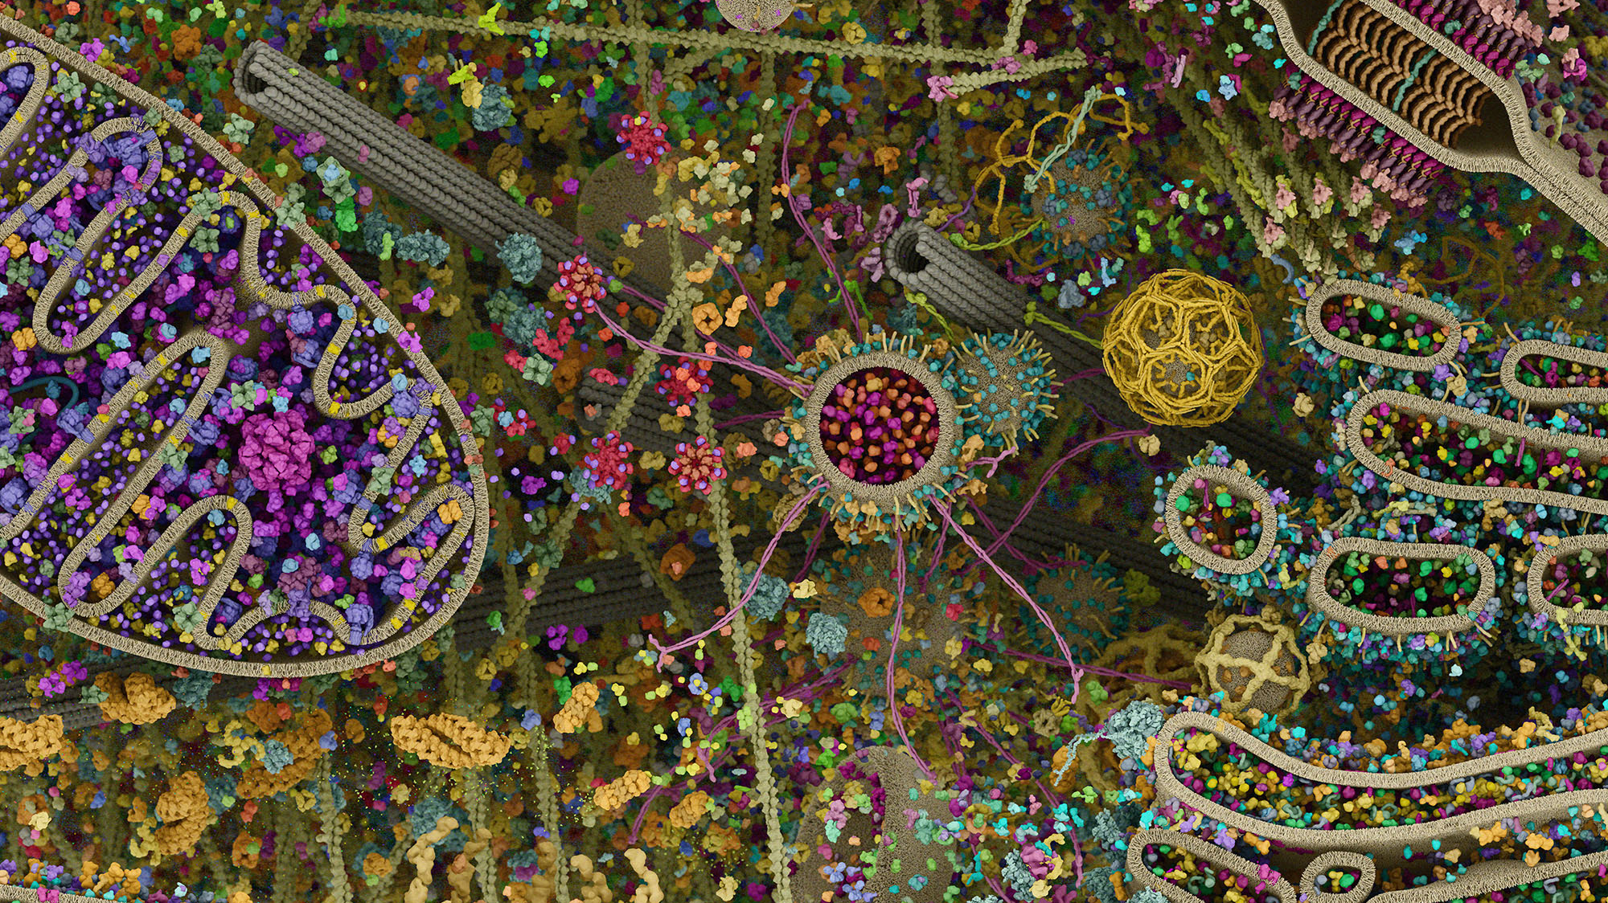

Slide 4
The Central Dogma of Molecular Biology
How are proteins created?
Translation: mRNA → Polypeptide
Highly redundant coding
Transcription: DNA → mRNA
Folding: Polypeptide → Protein
Notes:
Transcription: DNA -> mRNA
Translation: mRNA -> Protein
Explain:
- codons (and special ones)
- tRNA

Slide 5
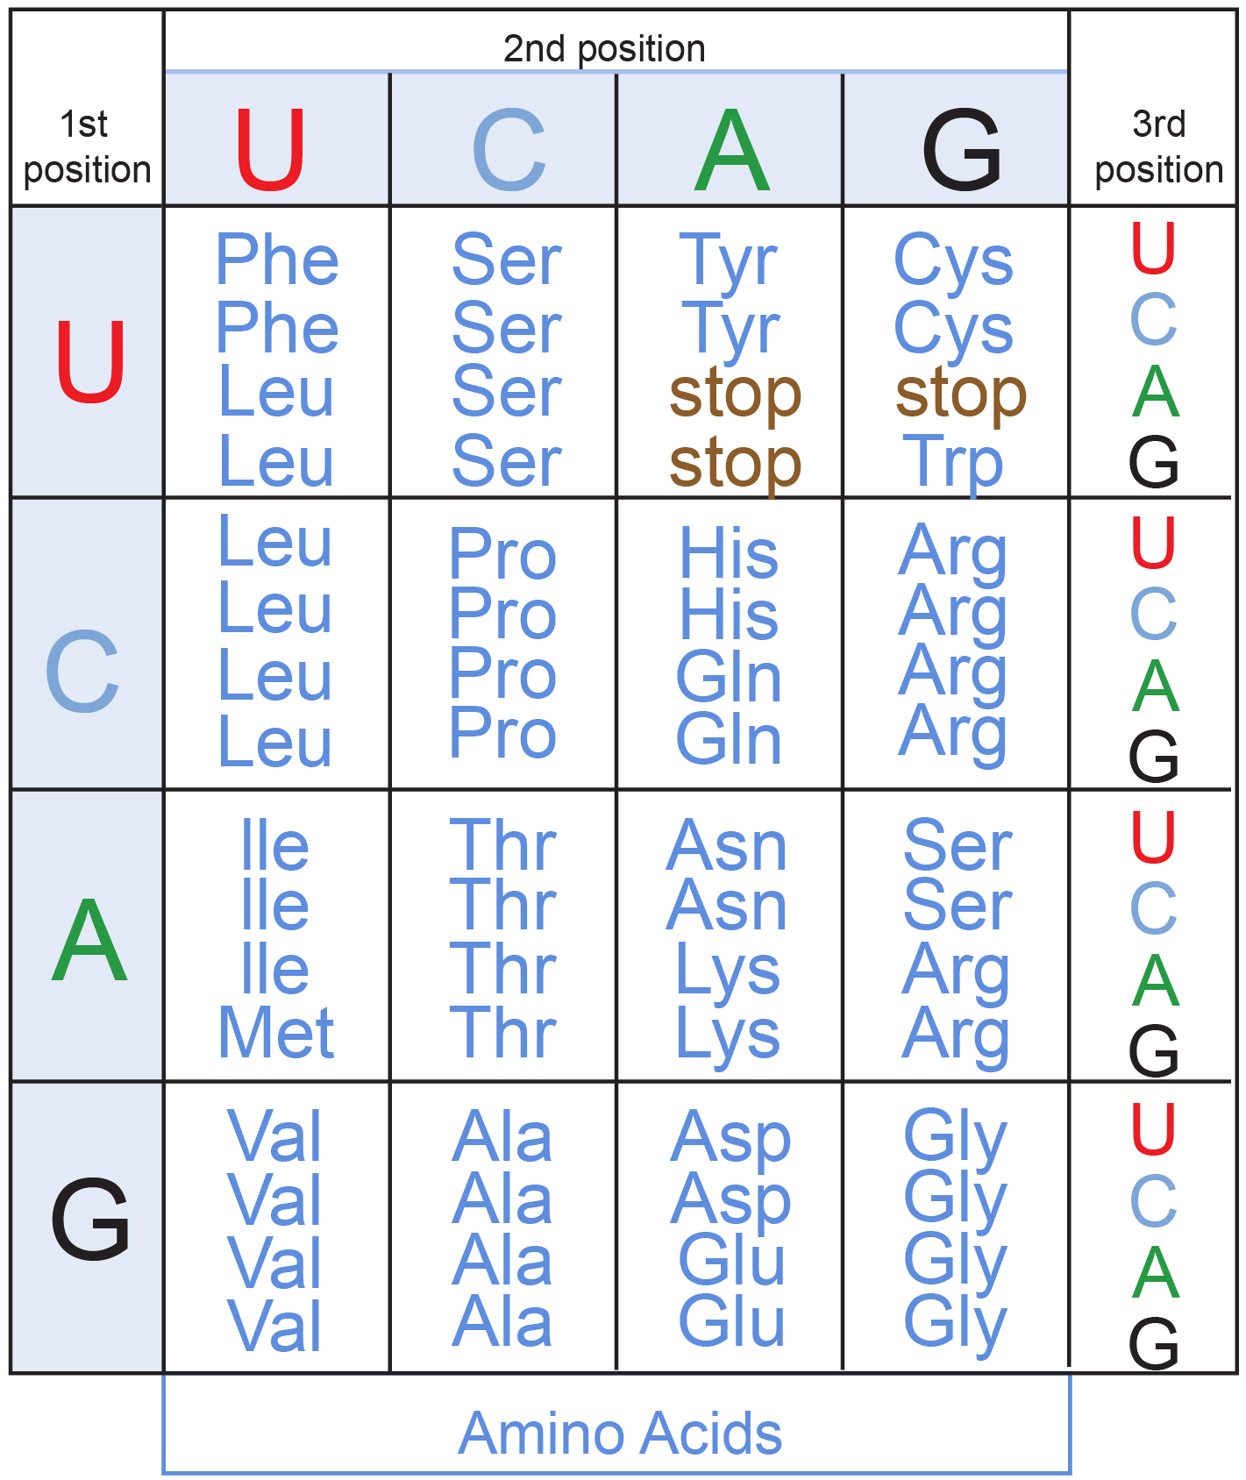
Translation & Genetic Code
Genetic code is highly redundant
61 codons encode 20 AAs (+3 stop)
~30 tRNAs bind to 61 codons
Universal codon to AA mapping
The reason for redundancies is not fully understood
Notes:
This table is known as the genetic code and it's a mapping from codon to AAs which is common to almost all life on earth.

Slide 6
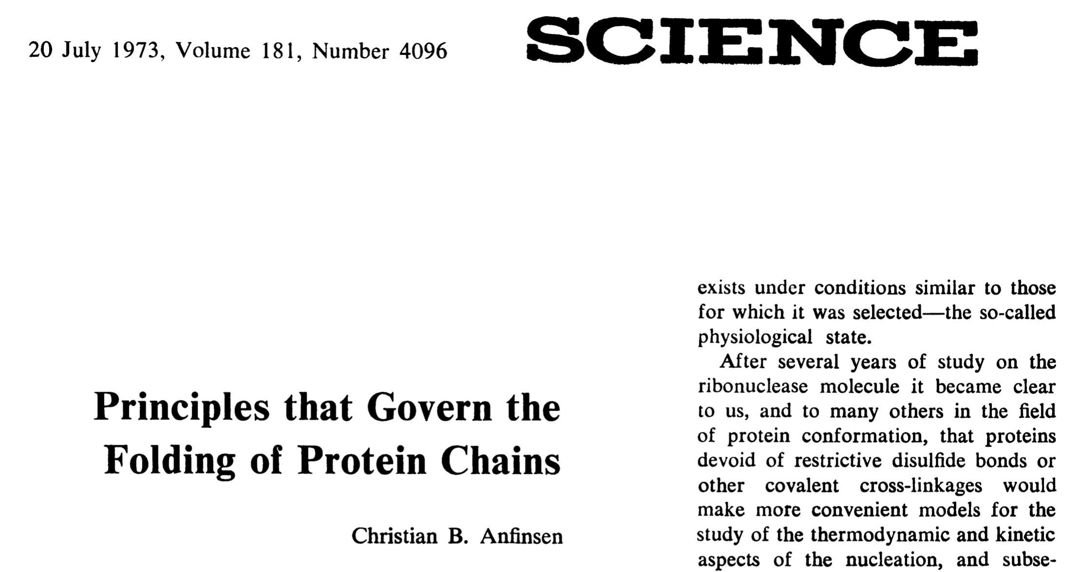
Anfinsen’s Principle
(Nobel Prize laureate)
Native structure is determined only by the protein's amino acid sequence.
Corollary: The identity of codons doesn’t influence structure, only the AAs they code for.
Notes:
Anfinsen observed that denatured proteins can fold back to their natural conformation.
Today this is known to only be true for small and globular proteins.
In general it is knows that some proteins have a non-unique energy minima so they can obtain multiple similar conformations.

Slide 7
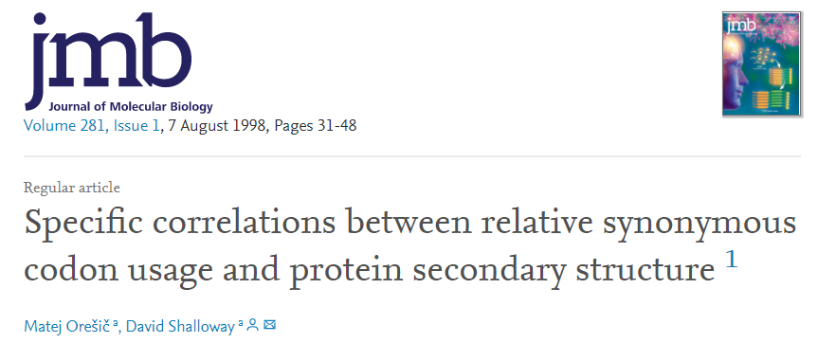
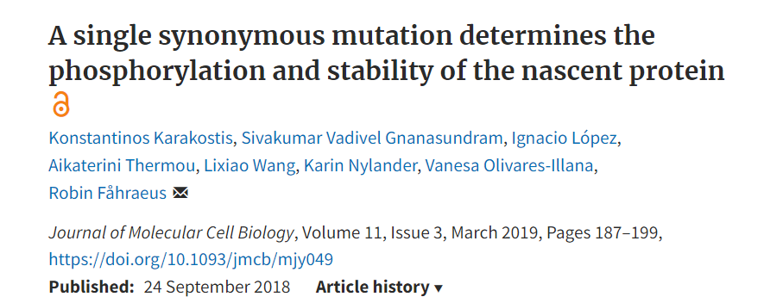
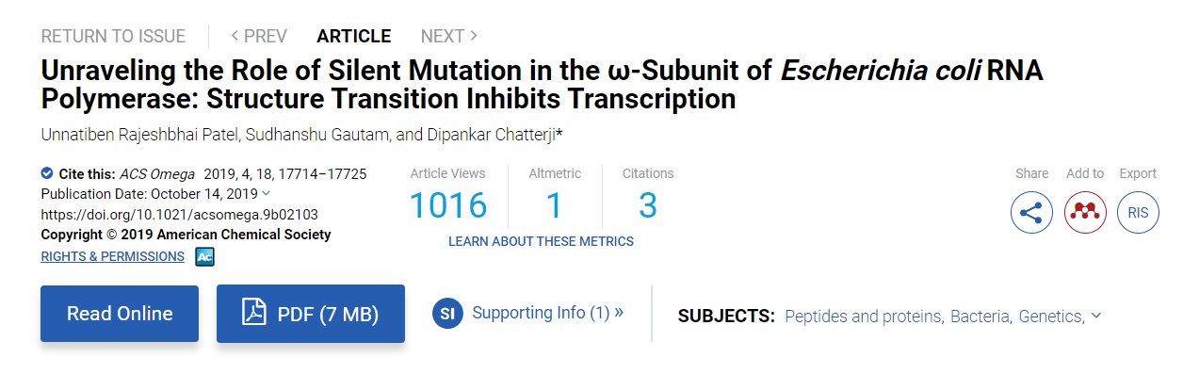
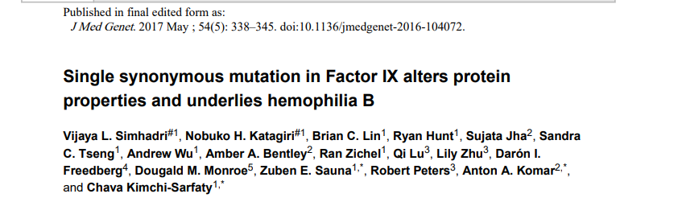
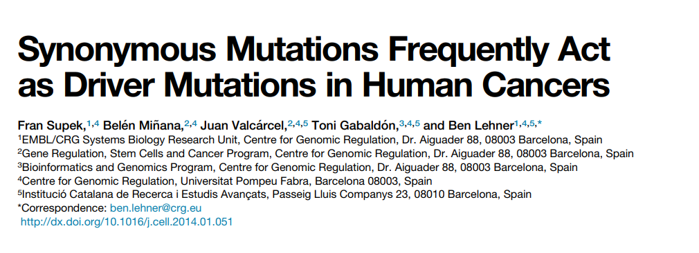
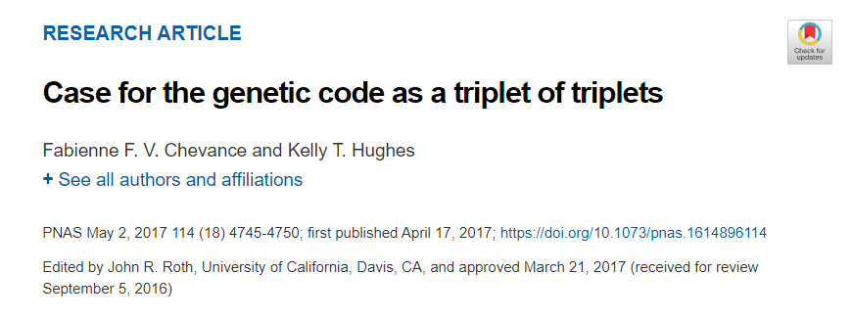
Notes:
an L22L synonymous mutation to p53 prevents MDM2 aided phosphorylation (Karakostis et al., 2019), an A82A mutation on the ω subunit of RNA polymerase changes the helicity of the isolated subunit and renders the complex inactive (Rajeshbhai Patel et al., 2019), a V107V mutation to human Factor IX is implicated in Hemophilia B (Simhadri et al., 2016), and T6T together with P8P mutations in the Salmonella flgM gene produces a 600-fold change in FlgM activity (Chevance and Hughes 2017). In a different line of work, Oresic and Shalloway (1998) found that the termini of secondary structures are favoured by a particular synonymous codon of Asp in humans and Asn in

Slide 8
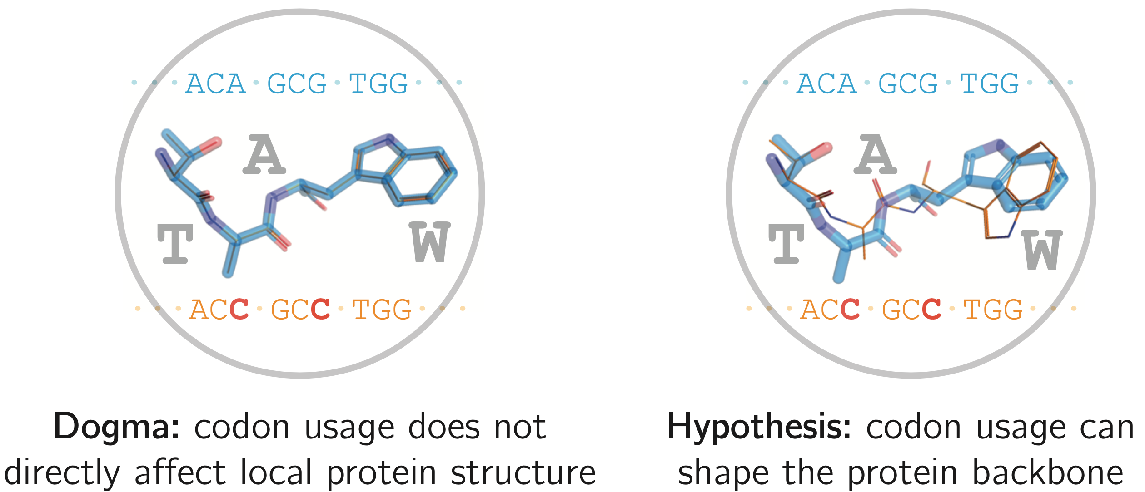
Our hypothesis: codons affect local structure
Local structure: Backbone angles at the specific position of a codon
Notes:
This is not to say that AA sequence is not the dominating factor; it’s to say that for some proteins (e.g. ones with non-unique energy minima) and some locations, codons can locally affect structure.

Slide 9
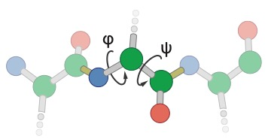
Backbone Torsion Angles
Ramachandran Plot
Left-handed
HELIX
SHEET
HELIX
Notes:
di-hedral = two "plane", angle between two planes
Note that the backbone here goes from bottom (N terminus) to top (C terminus)
Ramachandran plot: without P, G, I and V; non-redundant PDB structures; Inner countour is 98% of data, outer is 99.95%.
Mention that the dihedral angles live on a torus.

Slide 10
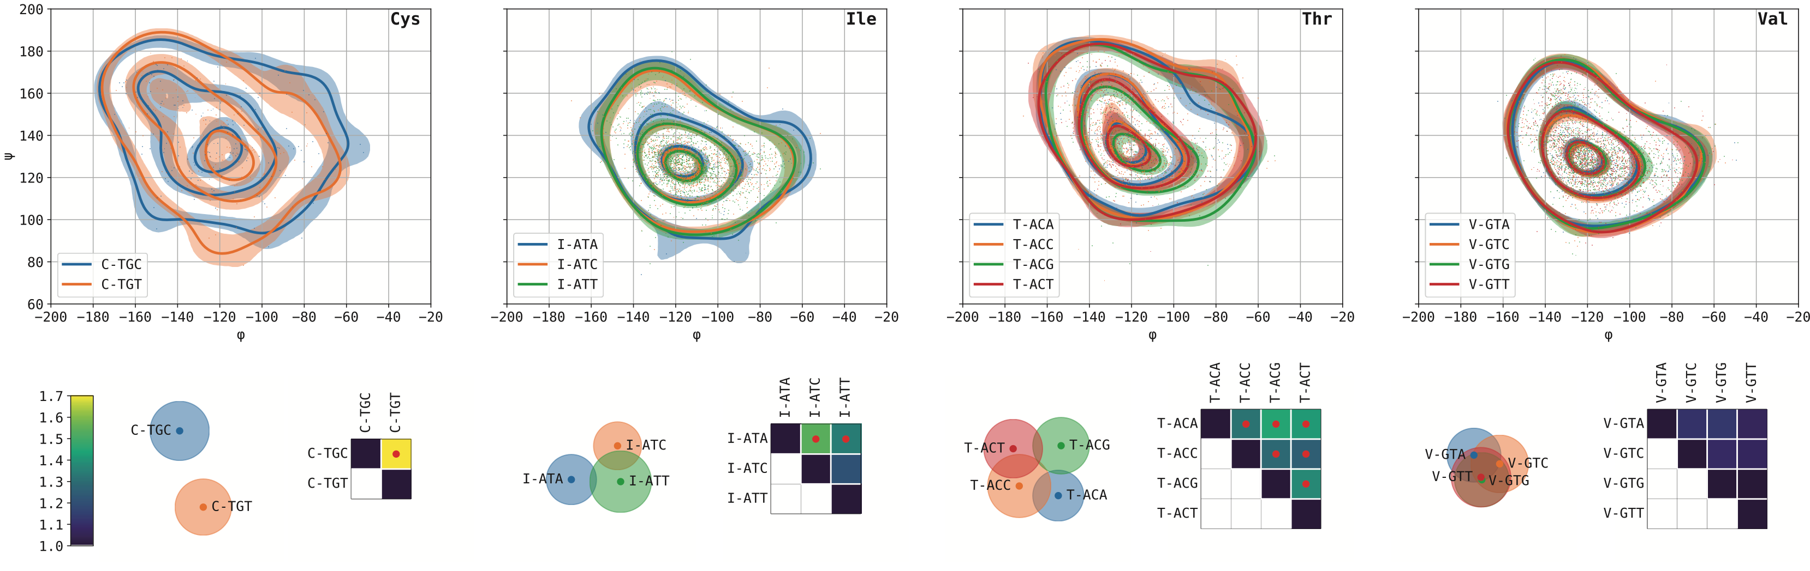
Rosenberg A. A., Marx A., Bronstein, A. M.
“Codon-specific Ramachandran plots show amino acid backbone conformation depends on identity of the translated codon.” Nature Communications (2022)
Ackerman-Schraier, L., Rosenberg, A.A., Marx, A., Bronstein, A. ”Machine learning approaches demonstrate that protein structures carry information about their genetic coding”. Scientific Reports 12, 21968 (2022).

Slide 11

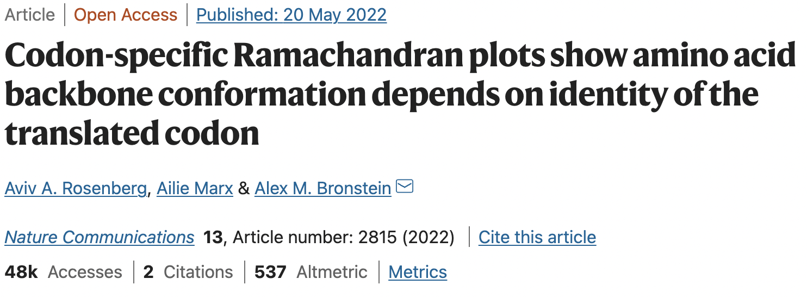

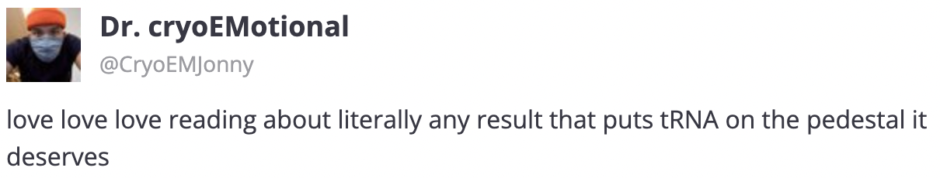
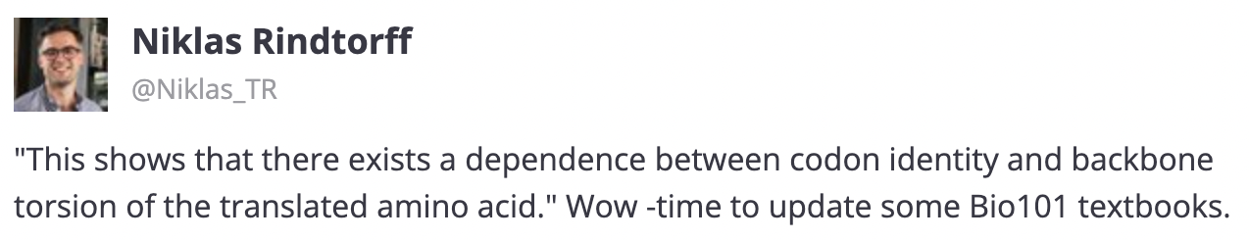
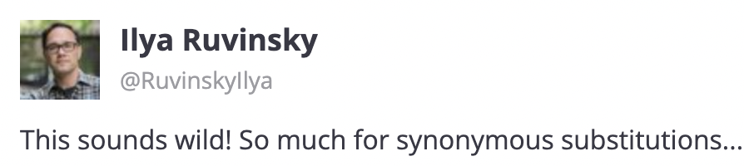
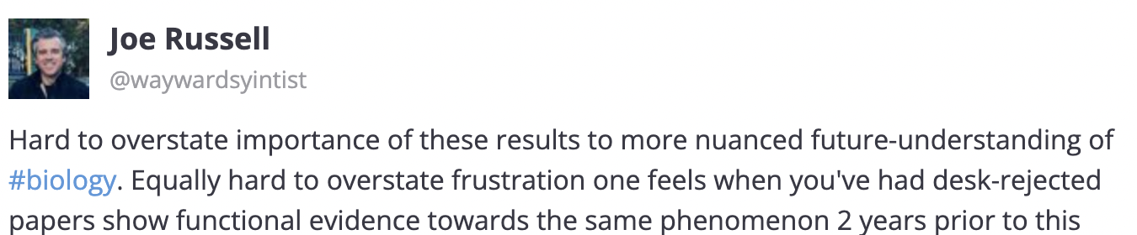


Slide 12
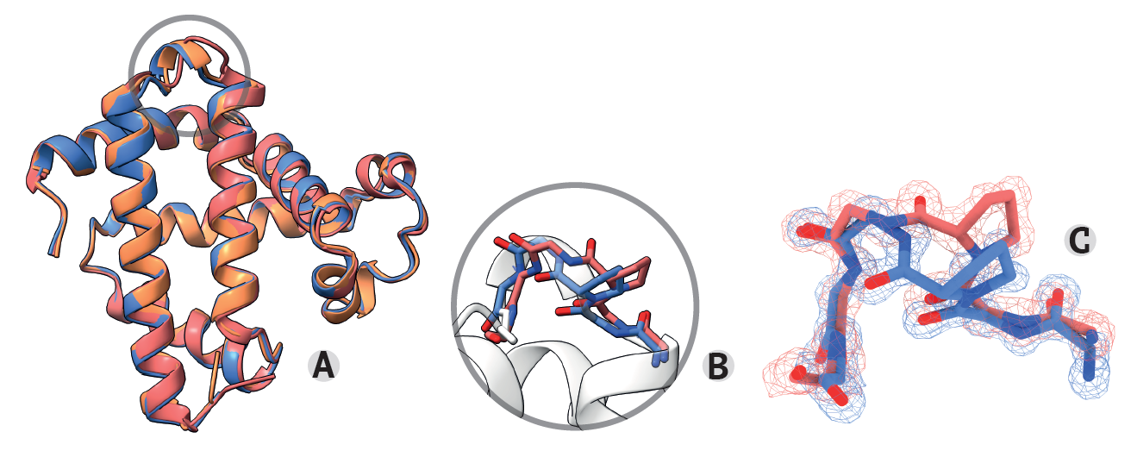
Rosenberg A.A., Bronstein A.M. & Marx A. Does one sequence always translate to one structure? (2023) in review, Nature Struct. & Mol. Biology
Identify, in pairs of homologous proteins, specific positions with twisted backbones that cannot be attributed to the sequence or the environment

Slide 13
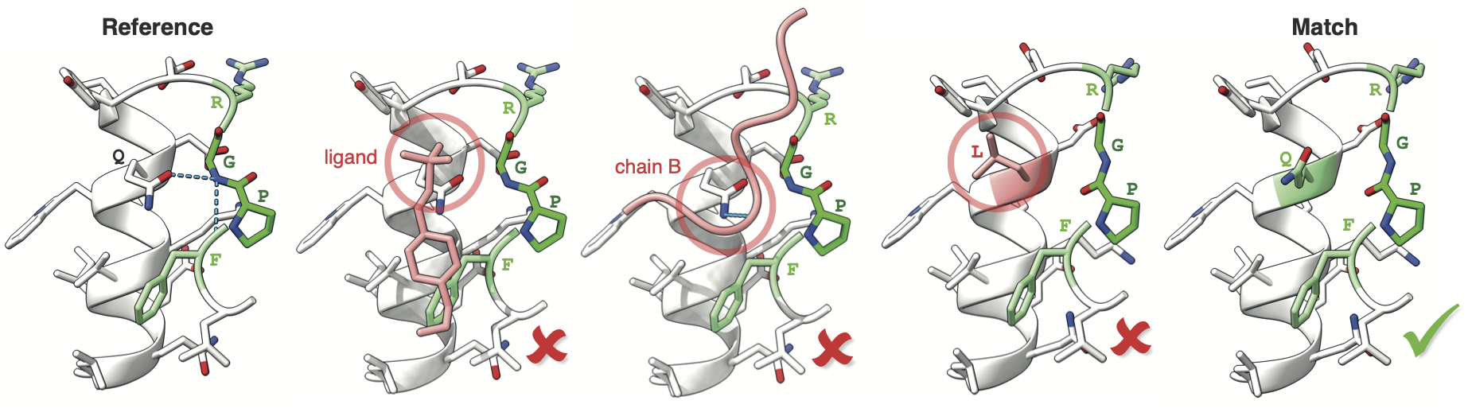
Context Matching: Controlling for Environment
Reference
Seq.+Struct. Similarity
Window: RGPF
Candidate 1
Candidate 2
Candidate 3
Match
different poential contact
Notes:
A reference structure is chosen for every unique protein
Contexts of 4-AAs are considered
Canditates are found by sequence and structure similarity
A match must have same potential interaction environment

Slide 14
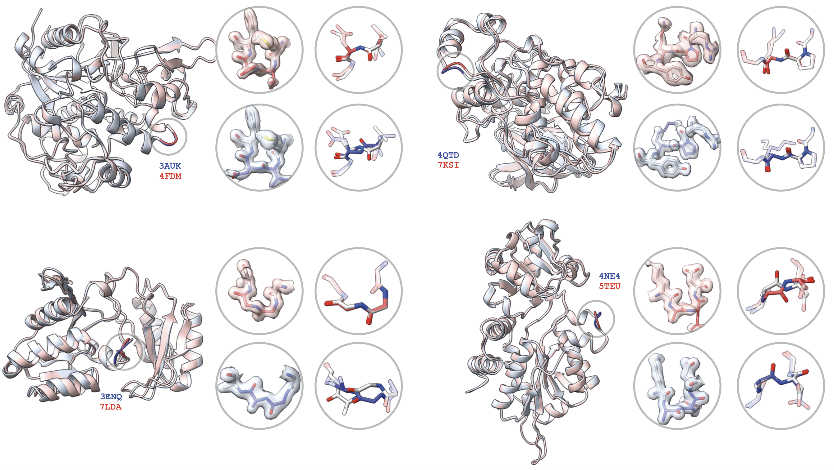
Defying “one sequence – one structure” dogma?
Backbone difference > 60º
Rosenberg A.A., Bronstein A.M. & Marx A. Does one sequence always translate to one structure? (2023)
Notes:
A reference structure is chosen for every unique protein
Contexts of 4-AAs are considered
Canditates are found by sequence and structure similarity
A match must have same potential interaction environment

Slide 15
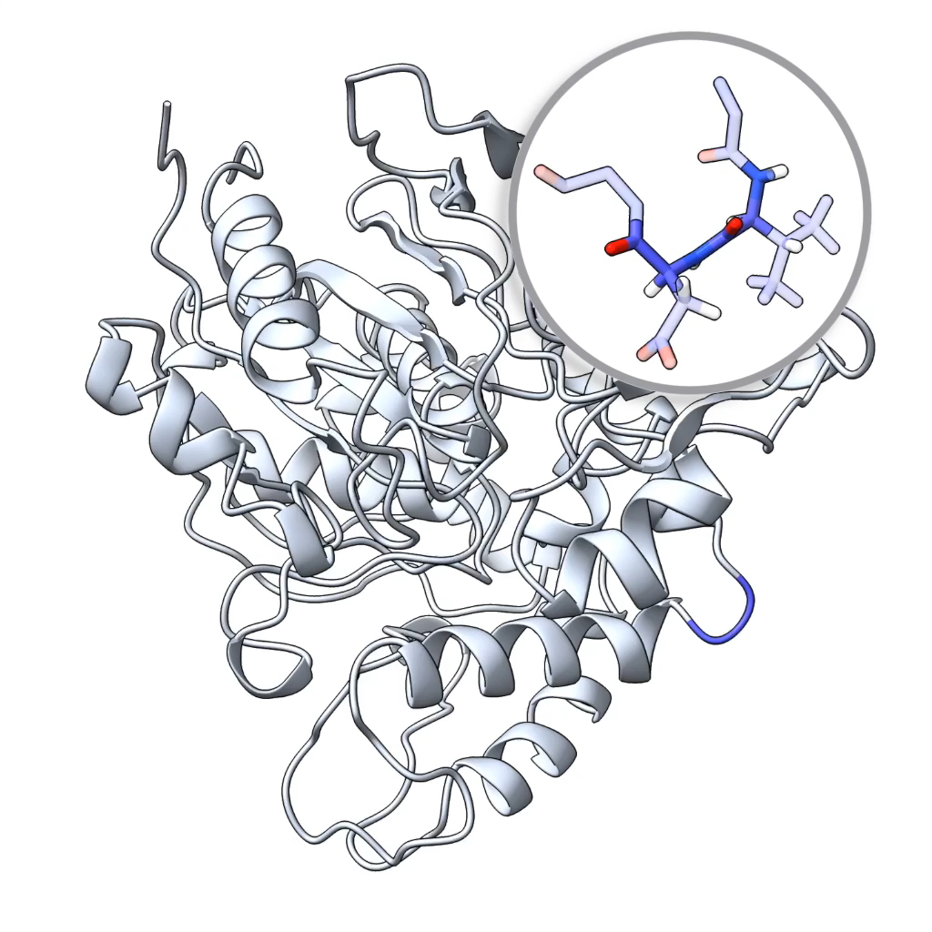

Slide 16
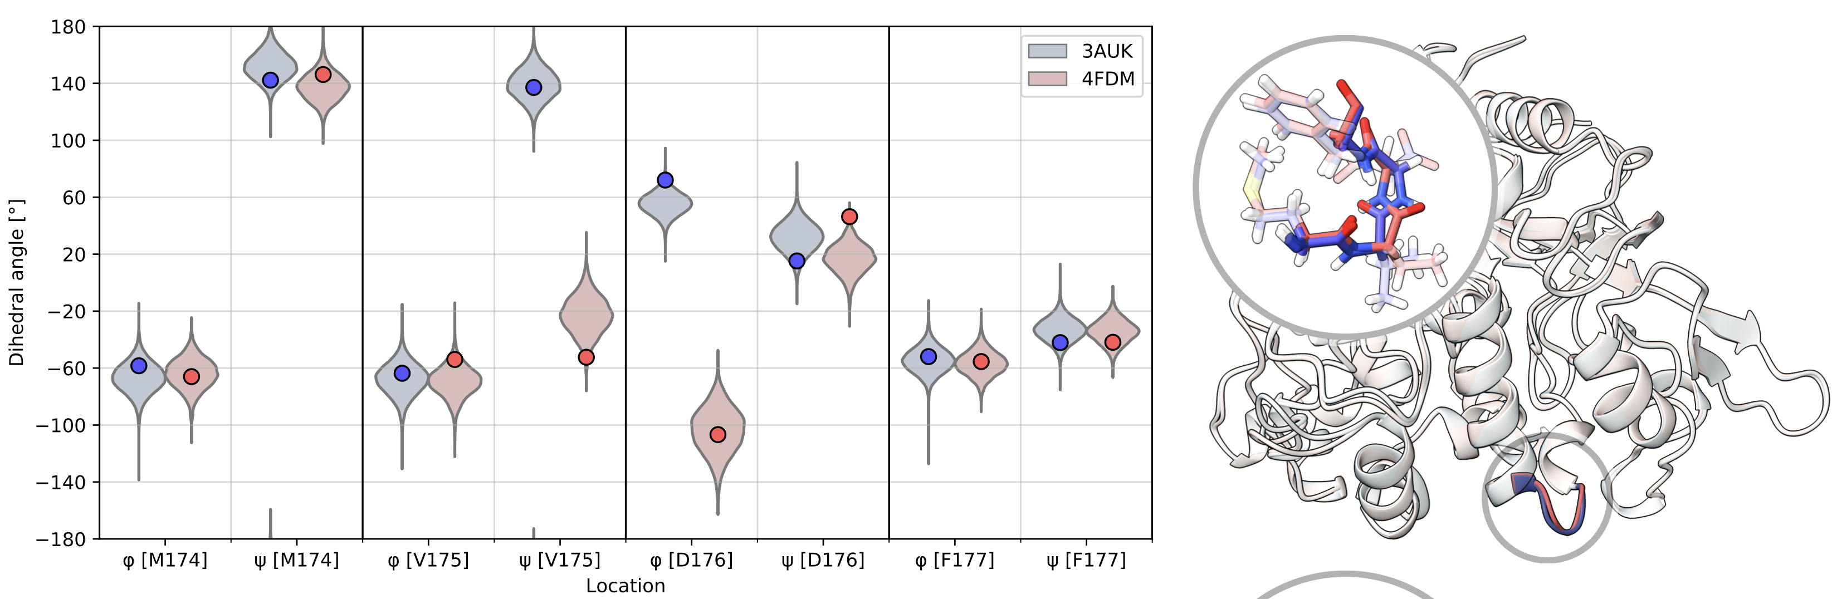
Alternate Conformations are Stable in Molecular Dynamics

Slide 17
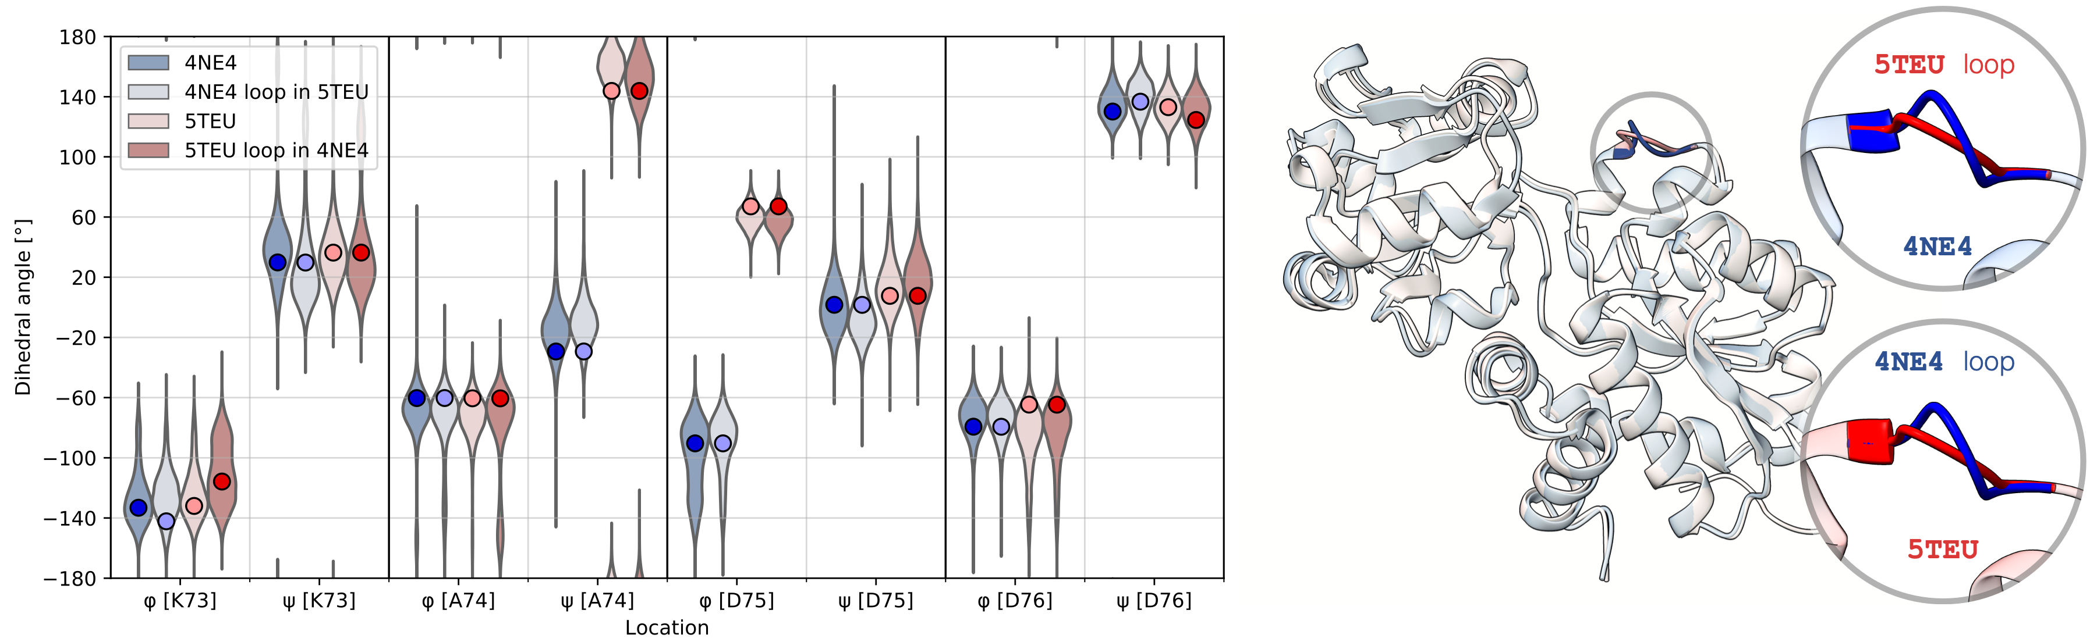
In situ chimeras remain stable
“transplant” loop from one structure into the other
Conformational difference remains stable even when transplanted into different structure

Slide 18
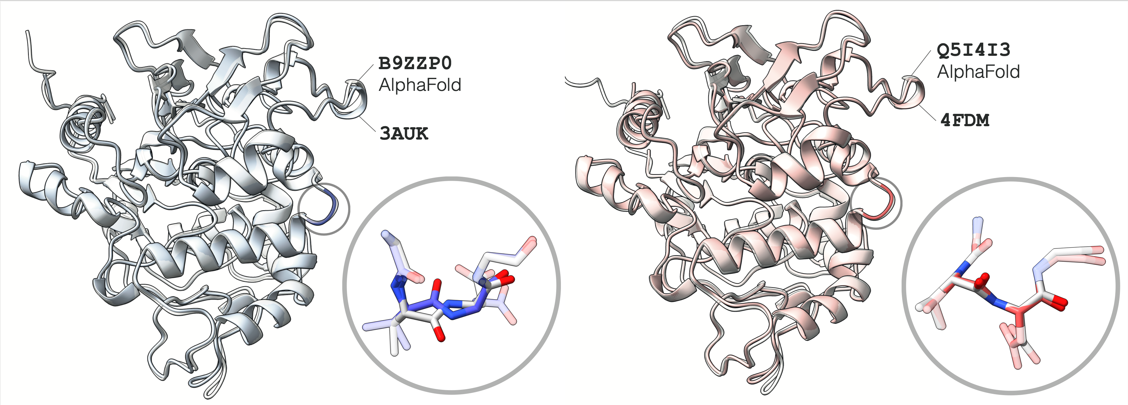

Alternate Conformations Not Predicted By AlphaFold
AlphaFold consistently mis-predicts one conformation from each match pair
Notes:
AF achieves very good prediction overall for these structures
(can go back to examples slide & show AF predictions)
This might be an indication that the structural difference is caused by mechanisms not described by the information contained in
the amino acid sequence alone.

Slide 19
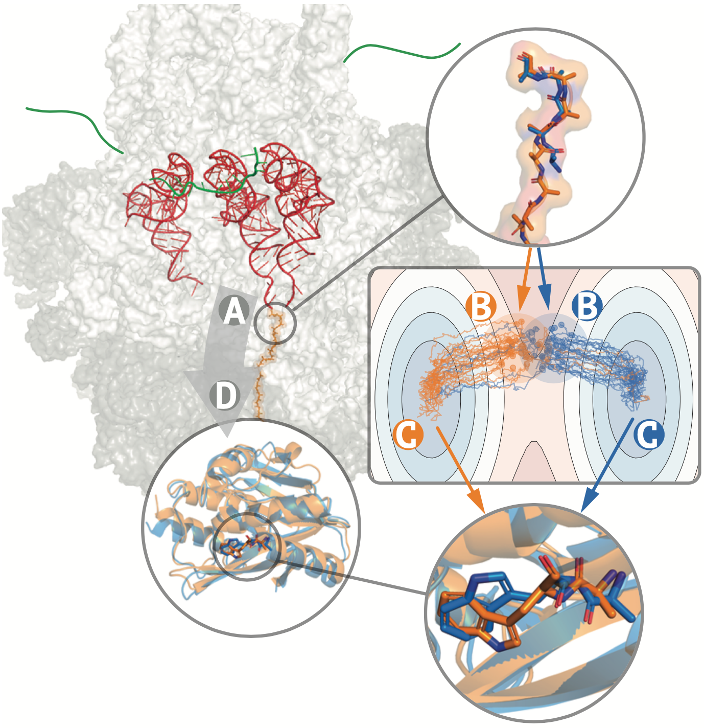
Our hypothesis: codons affect local structure
Synonymous codons may confer different initial conditions at translation time
These could create different energy minima which the protein folds into
Possible mechanisms: different tRNA binding or translation speed
Causal direction may only be determined by direct wet experiments

